Slide 1
Hypotheses

Slide 2
Question 1: How do dung beetle thermal tolerances respond in different climate zones?
H1: Beetles from the subtropics have lower CTmax and CTmin, but larger thermal tolerance range
CTmax
There is a larger temperature range and seasonal variance in the subtropics
CTmin
Subtropics
Tropics
Note: CTmax is the critical thermal maximum; CTmin is the critical thermal minimum
Sunday, Bates, and Dulvy 2011

Slide 3
Question 2: How do dung beetle thermal tolerances respond under different humidities?
H2: Increasing humidity decreases the CTmax of dung beetles
CTmax
Increasing humidity reduces the ability of the beetles to use evapotranspiration to thermoregulate
30% 50% 90%
30% 50% 90%
CTmin
%RH
%RH
Subtropics
Tropics
Raymond et al, 2020
Note: CTmax is the critical thermal maximum; CTmin is the critical thermal minimum

Slide 4

Question 3: Which functional and morphological traits influence humidity impact on beetles?
H3: Water loss proportion, body size, and wing size all impact beetles’ thermal tolerances, and how they adapt to changing humidity
Beetles use wing muscles to warm themselves at lower temperatures
CTmax
CTmax
CTmin
Beetles use water to thermoregulate
Larger beetles can lose more water, and thus survive at higher temperatures
Proportion of water lost
Body size
Wing size
Note: CTmax is the critical thermal maximum; CTmin is the critical thermal minimum
Nervo et al, 2021

Slide 5
Methods

Slide 6
Data analysis method: linear mixed models
Question 1: Impact of climate zones on thermal tolerance
CTmax or CTmin ~ climate zone + (1 | species)
(Species average CTmax – Species average CTmin) ~ climate zone
Question 2: Impact of humidity on thermal tolerance
CTmax or CTmin ~ climate zone * humidity + (1 | species)
Question 3: Impact of traits and interaction between traits and humidity on thermal tolerance
CTmax or CTmin ~ morphological traits * humidity

Slide 7
Results

Slide 8
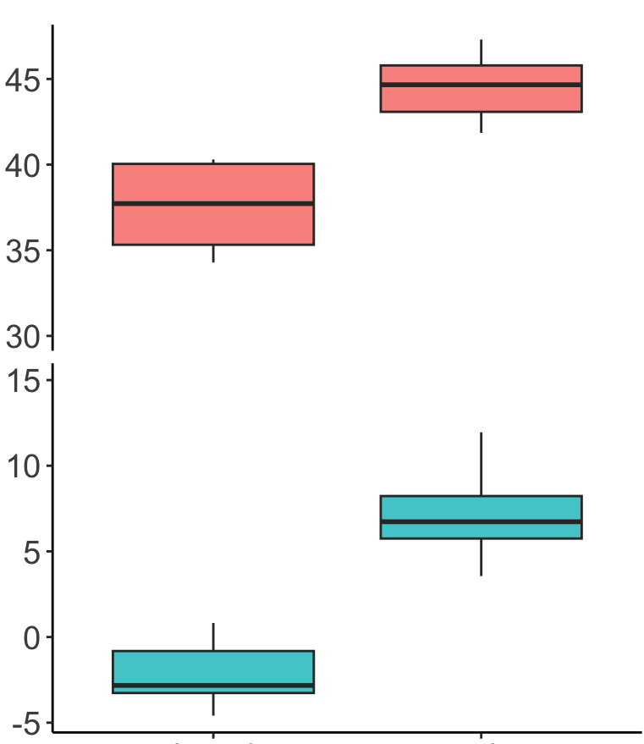
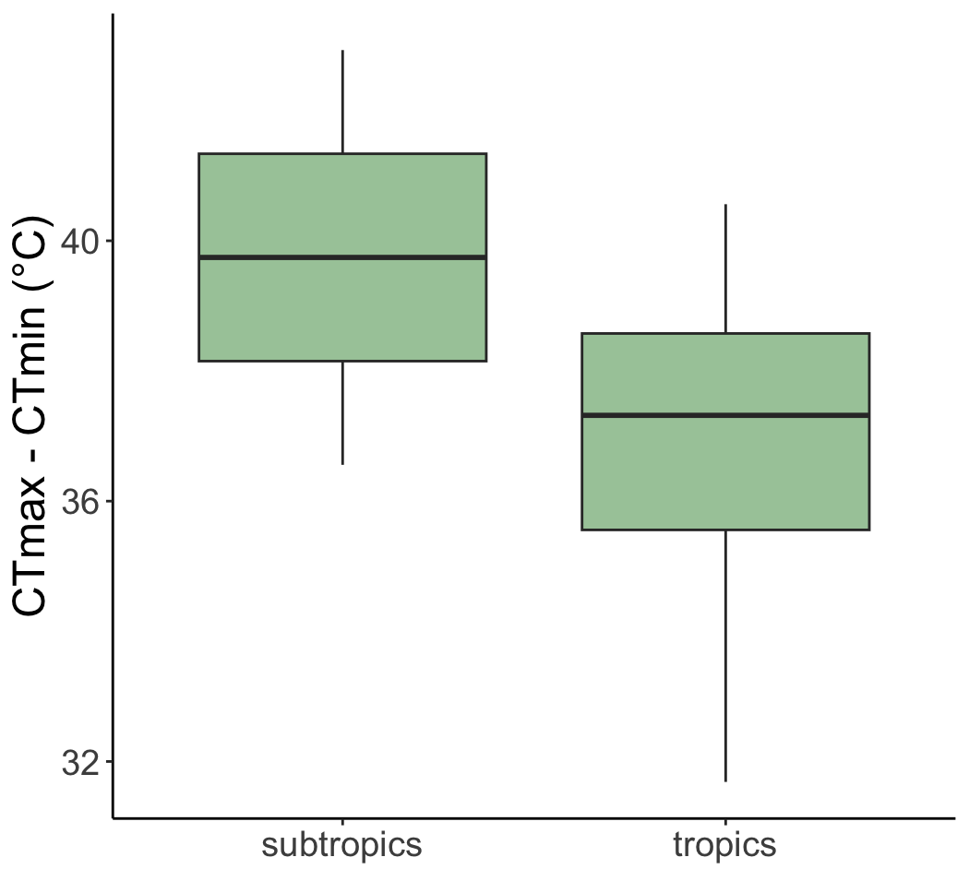
There are significant differences in CTmax and CTmin by climate zone
H1
CTmax and CTmin
Thermal tolerance range
a
b
a
a
p-value = 0.0106
R² = 0.6789
p-value = 0.367
R² = 0.1408
?
Humidity = 50%
Temperature (ºC)
A
B
CTmax – CTmin (ºC)
?
p-value = 0.0219
R² = 0.5757
subtropics
tropics
subtropics
tropics
n = 20
n = 50
n = 2
n = 5

Slide 9
There is spread by species, but differences between climate zones remain
H1
CTmax and CTmin at 50% humidity
subtropics
tropics
CTmax (ºC)
CTmin (ºC)
Species
n = 70 (5 for each treatment)

Slide 10
Humidity impacts beetles’ thermal tolerance
H2
subtropics
tropics
a
b
c
ab’
a’
b’
n = 55
n = 25
Increasing humidity from 50% to 90% significantly decreases CTmax in both the tropics and subtropics
p-value 50 vs 90 = 0.0011
R² = 0.6719
Temperature (ºC)
A
A
A
A’
B’
A’
n = 20
n = 55
Impact on CTmin varies
Graph shows predicted values with 95% CI
Humidity (%RH)

Slide 11
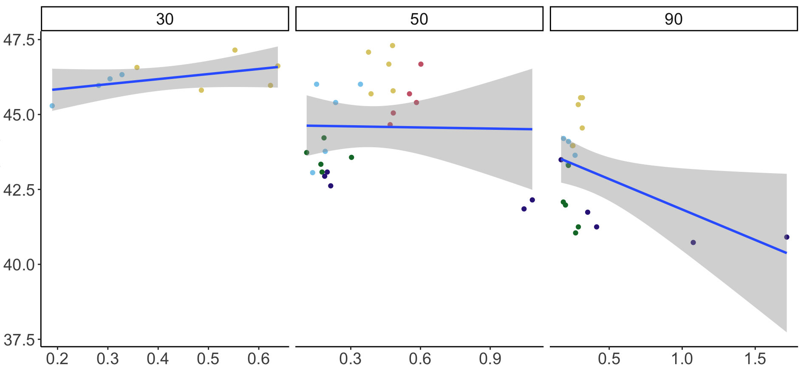

Beetles appear to be using water loss to thermoregulate…
H3
… but results are statistically insignificant
Humidity (%RH)
n = 54
p-values:
water loss proportion = 0.1021
water loss proportion * humidity = 0.1042
R² = 0.3983
Species
CTmax (ºC)
Most beetles appear able to use water loss to stay alive at higher temperatures at 30% and 50% humidity
However, beetles are unable to lose water and dying at lower CTmax at 90% humidity
Water loss / dry body weight *
* Calculated as (initial body weight – body weight after measurement) / dry body weight
Note: removed one outlier with <40ºC CTmax at humidity 30%

Slide 12
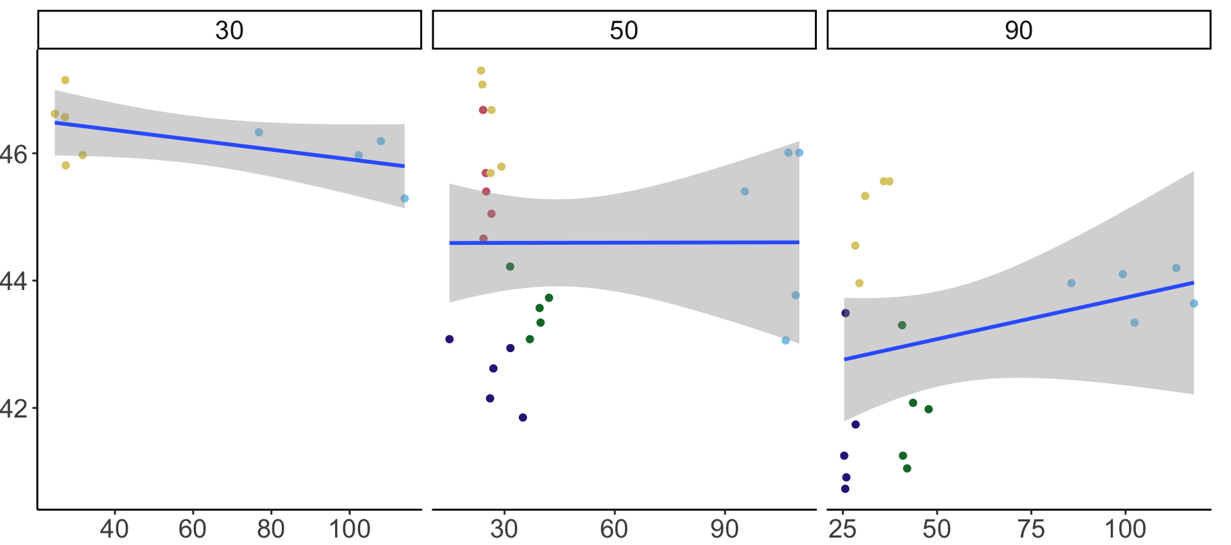
Interaction between body size and humidity is insignificant
H3
Humidity (%RH)
n = 54
p-values:
body size = 0.6512
body size * humidity = 0.4604
R² = 0.3587
CTmax (ºC)
Species
Our data does not have much variation in body size -- more samples are needed
Body size (mm²)
Note: removed one outlier with <40ºC CTmax at humidity 30%

Slide 13
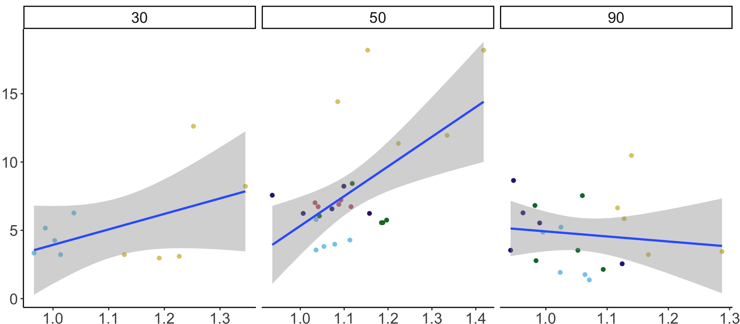
CTmin does significantly increase with relative wing size
H3
Humidity (%RH)
n = 55
p-values:
relative wing size = 0.0006
relative wing size * humidity = 0.04693
R² = 0.3502
Opposite to our expectation that beetles use wing muscles to heat themselves to stay alive at low temperatures (Nervo et. al, 2021)
Species
CTmin (ºC)
Relative wing size *
* Calculated as length of semi major axis of wing / length of the semi major axis of body

Slide 14
Backup slides

Slide 15
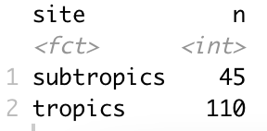
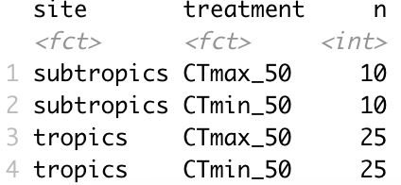
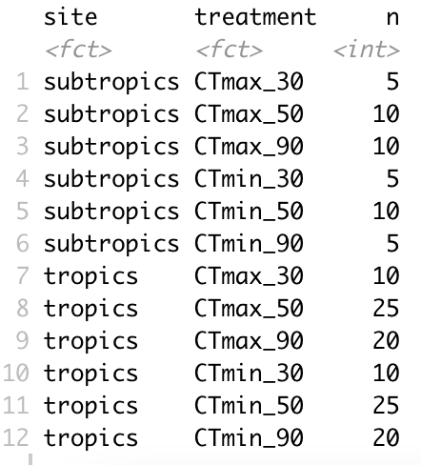
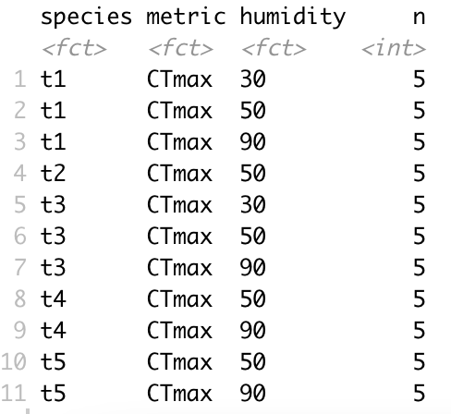
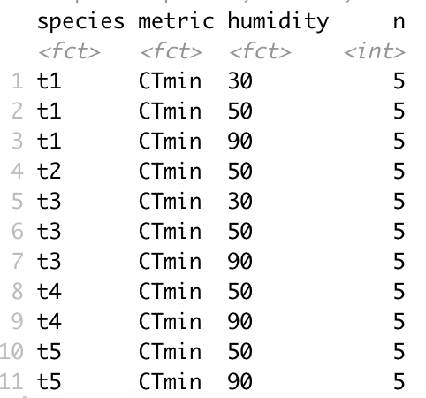
Number of individuals (n)
Total subtropics and subtropics
Hypothesis 1 (humidity =50%)
Total by treatment
Hypothesis 3 (tropics only)
Tropics CTmax (n=55)
Tropics CTmin (n=55)

Slide 16
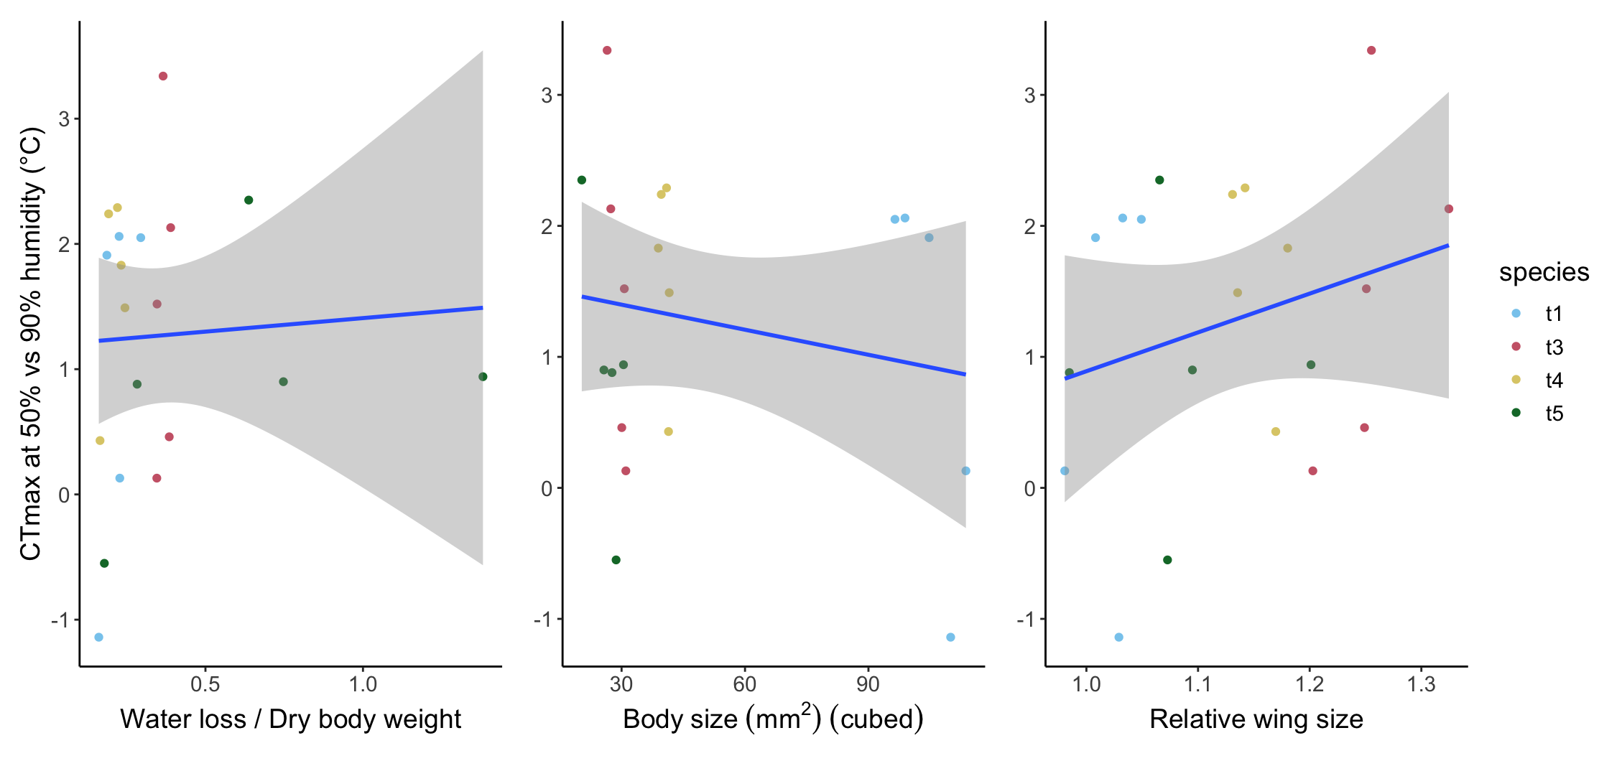
CTmax at 50% vs 90% humidity
Analysis of change in CTmax from 90% to 50% humidity with random pairs, n=25 (5 per species)
p-value = 0.8179
p-value = 0.455
p-value = 0.2585
1
2
1. Calculated as (initial body weight – body weight after measurement) / dry body weight 2. Calculated as length of semi major axis of wing / length of the semi major axis of body

Slide 17
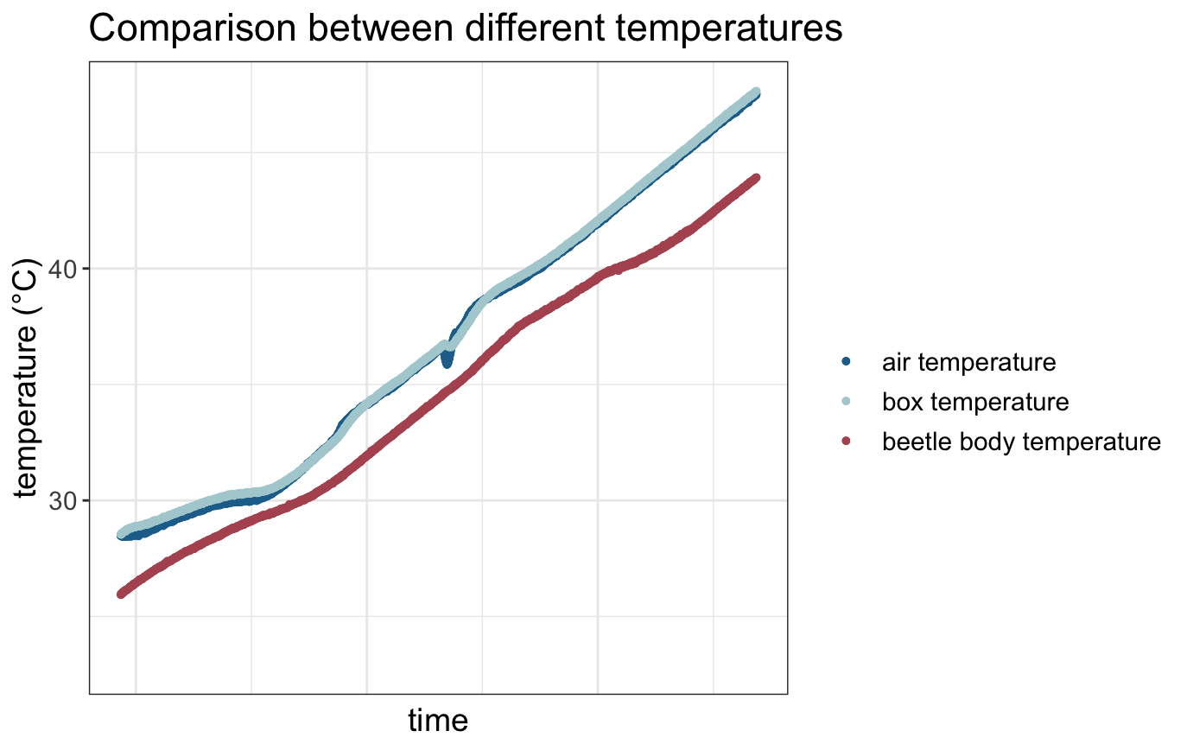
Machine temperature vs beetle temperature

